Slide 1
Database Users, Architecture and Components

Slide 2
Actors on the Scene
Database administrators (DBA) are responsible for:
Authorizing access to the database
Coordinating and monitoring its use
Acquiring software and hardware resources
Database designers are responsible for:
Identifying the data to be stored
Choosing appropriate structures to represent and store this data

Slide 3
Actors on the Scene (cont'd.)
End users
People whose jobs require access to the database. They are the clients of the database
Types
Naive or parametric end users
Sophisticated end users

Slide 4
End users
Casual or sophisticated end users
They are typically middle- high level managers
They need different information each time
They use sophisticated query language to specify their requests
Naïve or parametric end users
They make sizable portion of database end users
They query and update database using canned transactions that have been programmed and tested through graphic interface.

Slide 5
Actors on the Scene (cont'd.)
System analysts
Determine requirements of end users
Application programmers
Implement these specifications as programs

Slide 6
Database Management System Architecture

Slide 7
Centralized and Client/Server Architectures for DBMSs
Centralized DBMSs Architecture
All DBMS functionality, application program execution, and user interface processing carried out on one machine

Slide 8
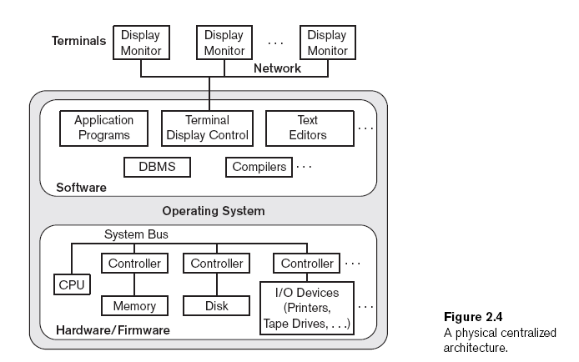

Slide 9
Basic Client/Server Architectures
Different servers are connected via network
Servers with specific functionalities
File server
Maintains the files of the client machines.
Printer server
Connected to various printers; all print requests by the clients are forwarded to this machine
Web servers or e-mail servers

Slide 10
Basic Client/Server Architectures (cont'd.)
Client ask for a request and server responds to that request
Client machines
Provide user with:
Appropriate interfaces to utilize these servers
Local processing power to run local applications
One machine can work as client and server.

Slide 11
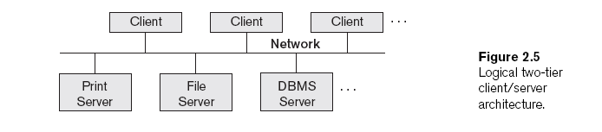
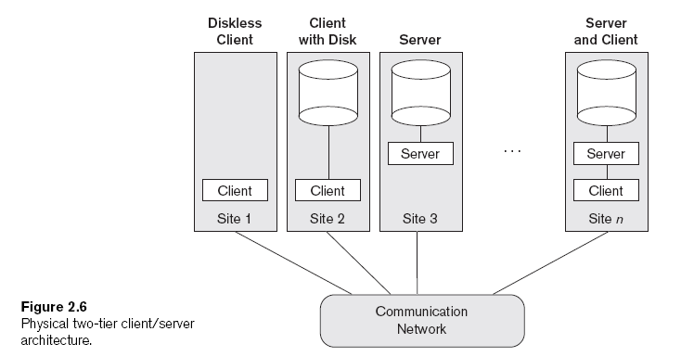

Slide 12
Basic Client/Server Architectures (cont'd.)
Client
User machine that provides user interface capabilities and local processing
Server
System containing both hardware and software
Provides services to the client machines
Such as file access, printing, archiving, or database access

Slide 13
Two-Tier Client/Server Architectures for DBMSs
Server handles
Query and transaction functionality related to SQL processing
Client handles
User interface programs and application programs

Slide 14
Two-Tier Client/Server Architectures (cont'd.)
Open Database Connectivity (ODBC)
Provides application programming interface (API)
Allows client-side programs to call the DBMS
Both client and server machines must have the necessary software installed
JDBC
Allows Java client programs to access one or more DBMSs through a standard interface

Slide 15
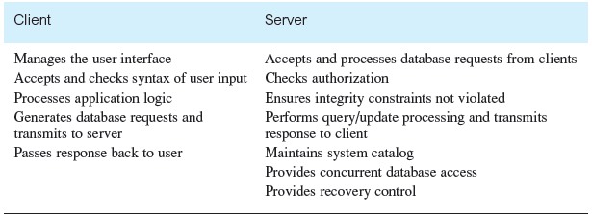
Summary of Client/Server functions

Slide 16
Three-Tier and n-Tier Architectures for Web Applications
Application server or Web server
Adds intermediate layer between client and the database server
Runs application programs and stores business rules
N-tier
Divide the layers between the user and the stored data further into finer components

Slide 17
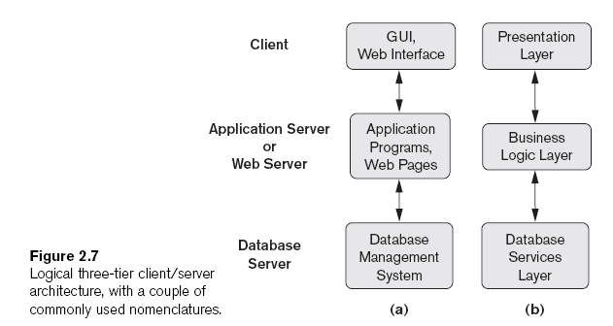

Slide 18
Database Functions

Slide 19
Services Provided by DBMS
Data storage, retrieval and update
A DBMS must provide users with the ability to store, retrieve, and update data in the database.
2. A user accessible catalog
A DBMS must provide a catalog in which descriptions of data items are stored and which is accessible to users.

Slide 20
Services Provided by DBMS (cont'd.)
3. Transaction Support
A DBMS must provide a mechanism which will ensure either that all the updates corresponding to a given transaction are made or that none of them is made.
4. Concurrency Control Services
A DBMS must provide a mechanism to ensure that the database is updated correctly when multiple users are updating the database concurrently.

Slide 21
Services Provided by DBMS (cont'd.)
5. Recovery Services
A DBMS must provide a mechanism for recovering the database in the event that the database is damaged in any way.
6. Authorization Services
A DBMS must provide a mechanism to ensure that only authorized users can access the database.

Slide 22
Services Provided by DBMS (cont'd.)
7. Support for data communication
A DBMS must be capable of integrating with communication software.
8. Integrity Services
A DBMS must provide a means to ensure that both the data in the database and changes to the data follow certain rules.

Slide 23
Services Provided by DBMS (cont'd.)
9. Services to promote data independence
A DBMS must include facilities to support the independence of programs from the actual structure of the database.
10. Utility Services
A DBMS should provide a set of utility services.(loading, backup, DB reorganization, performance monitoring)

Slide 24
Database Components

Slide 25
The Database System Environment
DBMS component modules
Buffer management(module to schedule disk read/write, because this has a considerable effect on performance)
Stored data manager(controls access to DBMS information that is stored on disk)
DDL compiler
Interactive query interface
Query compiler
Query optimizer
Precompiler

Slide 26
The Database System Environment (cont'd.)
DBMS component modules
Integrity Checker
Runtime database processor
System catalog
Concurrency control system
Backup and recovery system

Slide 27
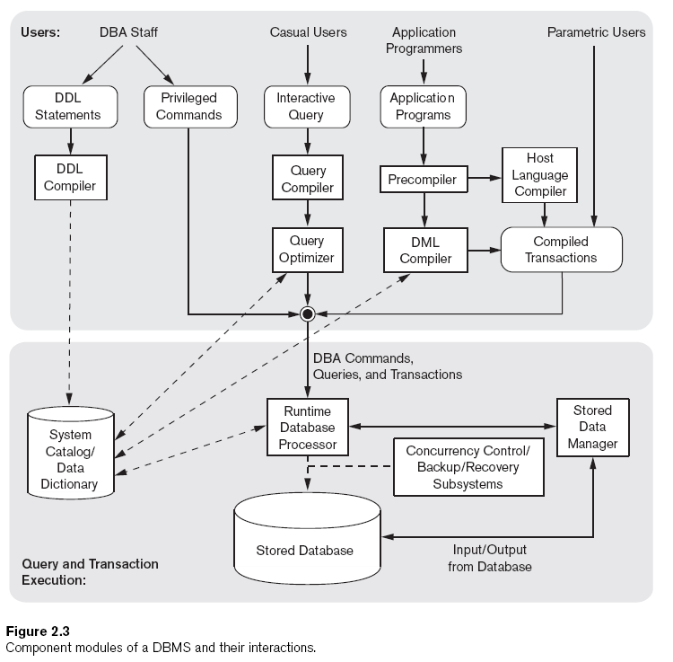

Slide 28
References for this lecture
Fundamentals of Database Systems, 10th edition. Elmasri, Navathe
- Database Systems: A practical Approach to Design, Implementation, and Management, 4th edition. Connolly, Begg

